Slide 1

Movie Revenue vs OMDb Rating
Exploratory Data Analysis Project
By:
Mohaib & Neetu

Slide 2

Research Questions:
Is a movie's revenue dependent on the ratings it earns?
Is the count of votes a key factor towards a movie's ratings?
Are there some genres that earn higher revenue despite receiving lesser votes or ratings?
Is there a correlation between a movie's ratings and revenue and count of votes and revenue?

Slide 3

The following observations were made:
Average count of votes a movie received was 1M.
Average revenue per movie was $158M.
Average rating was 8.0

Slide 4

Revenue Analysis
The genre ‘Action, Drama, Thriller’ was the top earning revenue, followed by ‘Animation, Adventure, Drama’
While the categories ‘Crime, Thriller’ and ‘Comedy, Drama’ did not do very well in terms of revenue

Slide 5


Count of Votes Analysis
The genre ‘Drama, Romance’ earned the highest number of votes but this category stood at 6th rank (out of 44) for the revenue it earned
The genre ‘Drama’ earned second highest count of votes, but it stood at 25th position in the ranking

Slide 6

Ratings Analysis
The categories that earned the highest revenue were rated lower compared to other categories i.e., rated 8.0, while the highest rating observed in this dataset was 9.3.

Slide 7
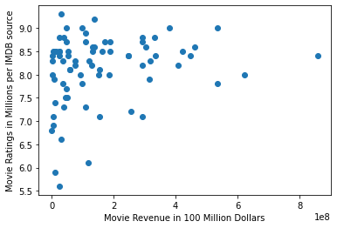
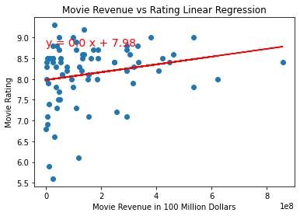
Correlation Analysis
Is a movie's revenue dependent on the ratings it earns?
Regression line equation is: y = 0.0 x + 7.98 The r-squared is: 0.21538940663785827 The regression shows a positive correlation. Movie's revenue has weak correlation to its ratings.
“The correlation between both factors is 0.22”

Slide 8
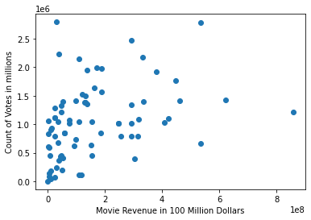
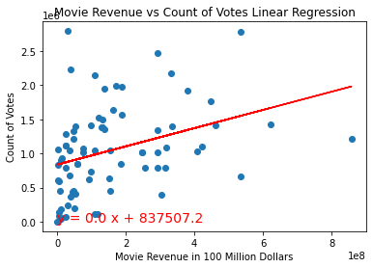
Correlation Analysis
Is the count of votes a key factor towards a movie's ratings?
Regression line equation is: y = 0.0 x + 837507.2 The r-squared is: 0.3534131654904985 The regression shows a positive correlation. Movie's revenue is an indication of higher votes counts it receives.
“The correlation between both factors is 0.35”

Slide 9
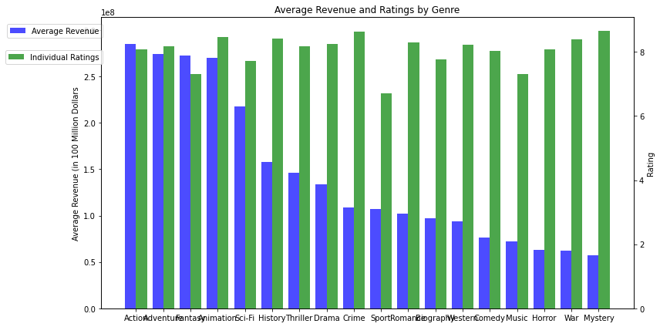
Are there some genres that earn higher revenue despite receiving lesser votes or ratings?

Slide 10
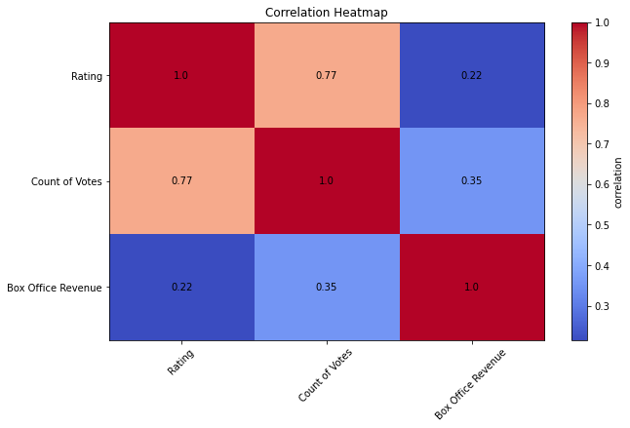

Is there a correlation between a movie's ratings and revenue and count of votes and revenue?

Slide 11
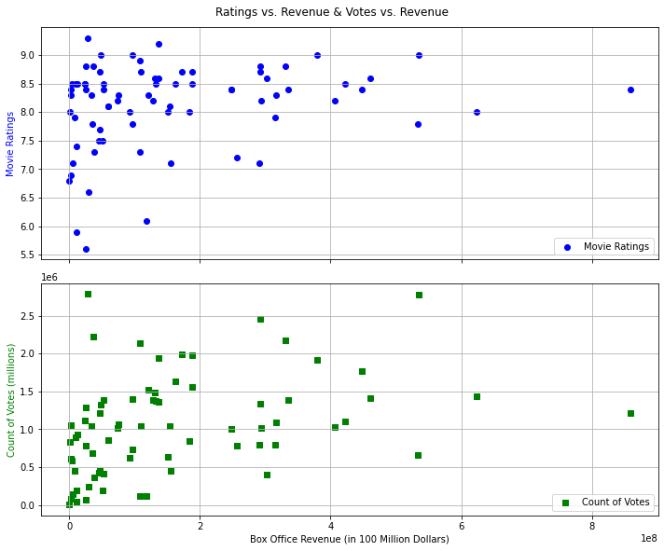

Is there a correlation between a movie's ratings and revenue and count of votes and revenue?

Slide 12

Hypothesis
Null Hypothesis: There is no correlation between a movie's revenue and its ratings or count of votes.
Alternate Hypothesis: Count of votes and movie's ratings contribute to movie's revenue and success
Ttest_1sampResult(statistic=-3.4723648209376736, pvalue=0.007022539912102872)

Slide 13
Key findings and conclusions:
Positive but weak correlations between movies revenue and ratings /count of votes.
Count of votes or ratings not a deciding factor towards a movie's success or a failure, however to an extent may contribute to movie's earnings
The t-test earned a score of less than 0.05 which means the the null hypothesis that there is no correlation between movie's revenue and its ratings/count of votes is rejected.

Slide 14

Questions?

